Slide 1

Facility Location Problem
Alexander Hauer

Slide 2
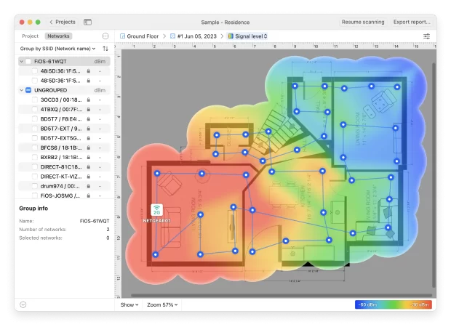
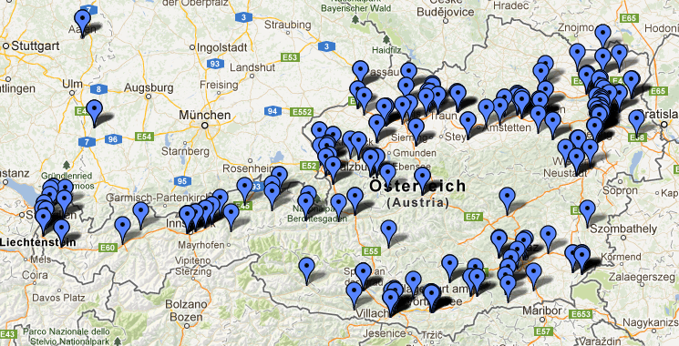
Why this?
Facility Location is a commonly met problem by businesses.

Slide 3


It requires a solution that is both efficient and accurate.
The correct solution lowers the cost and helps resource management.

Slide 4
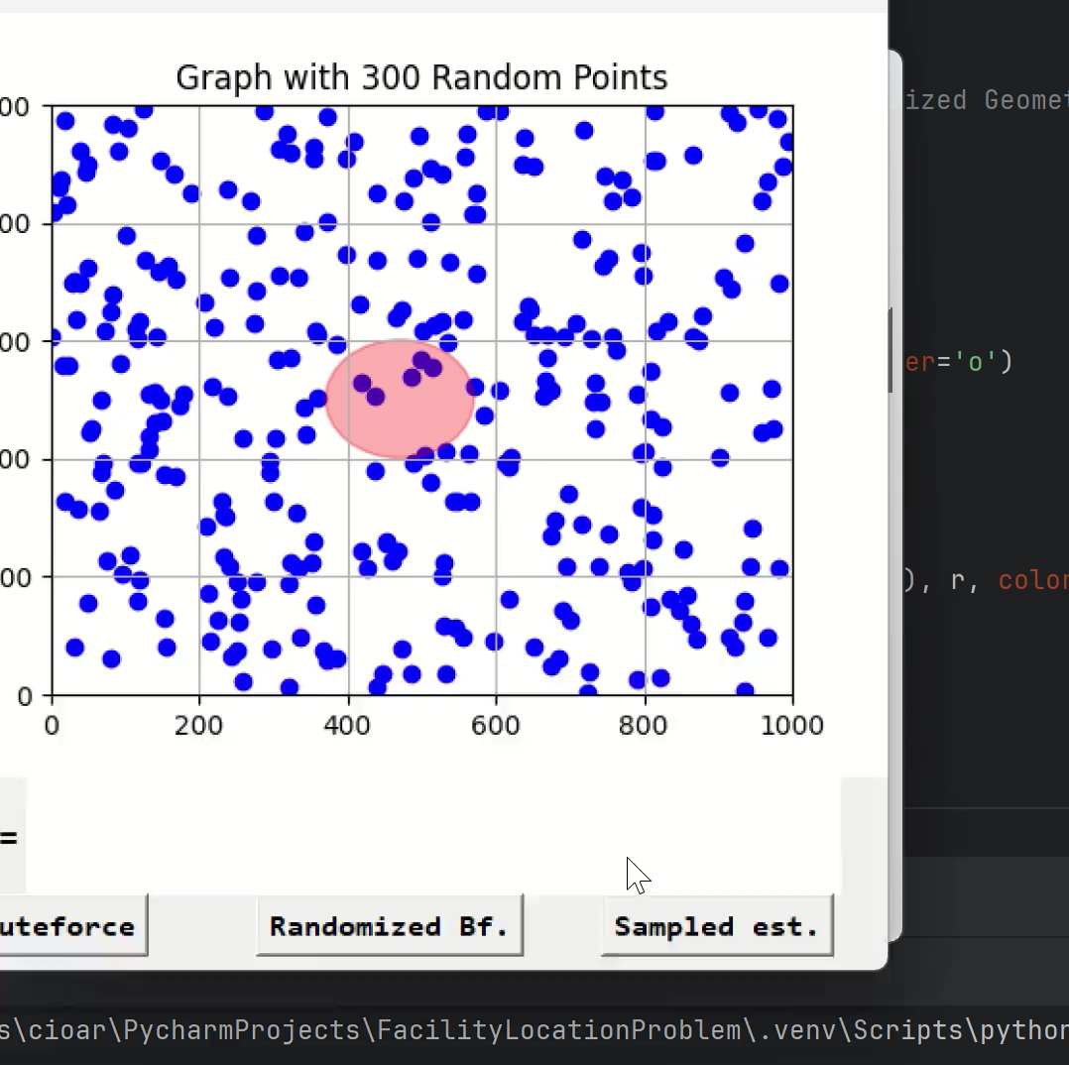
Application presentation
The application features an interactive GUI
Multiple methods for finding the solution with varying strengths and weaknesses

Slide 5
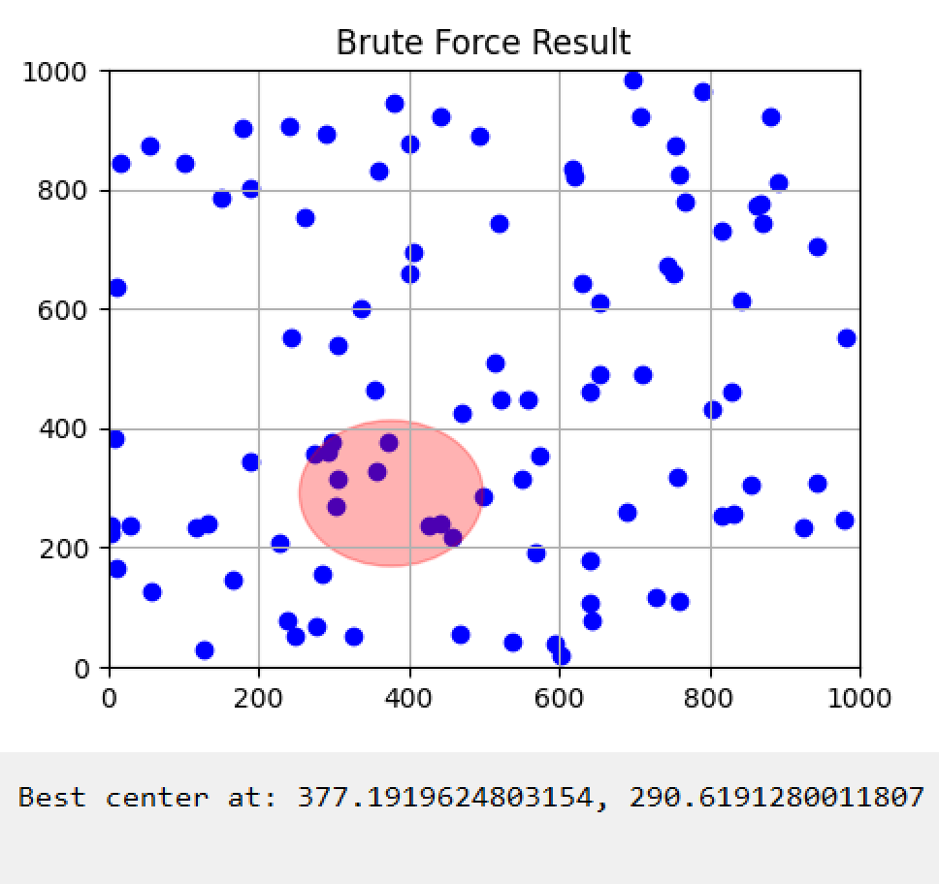
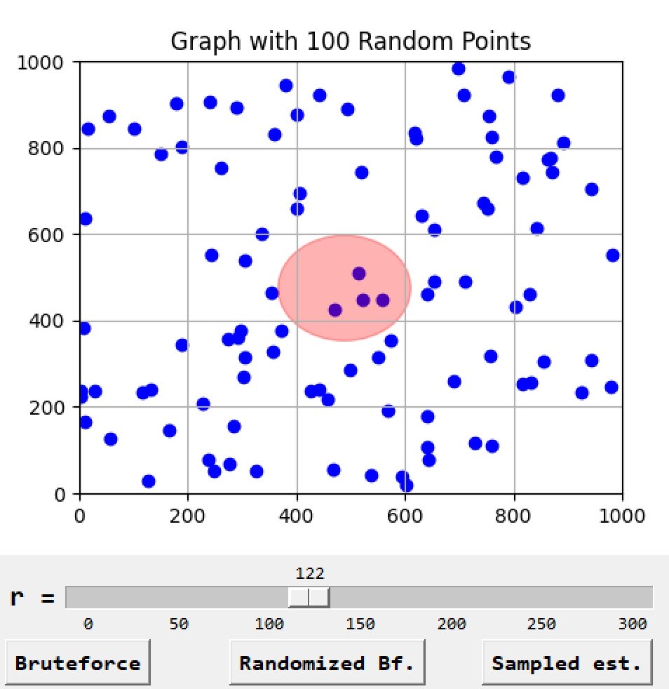
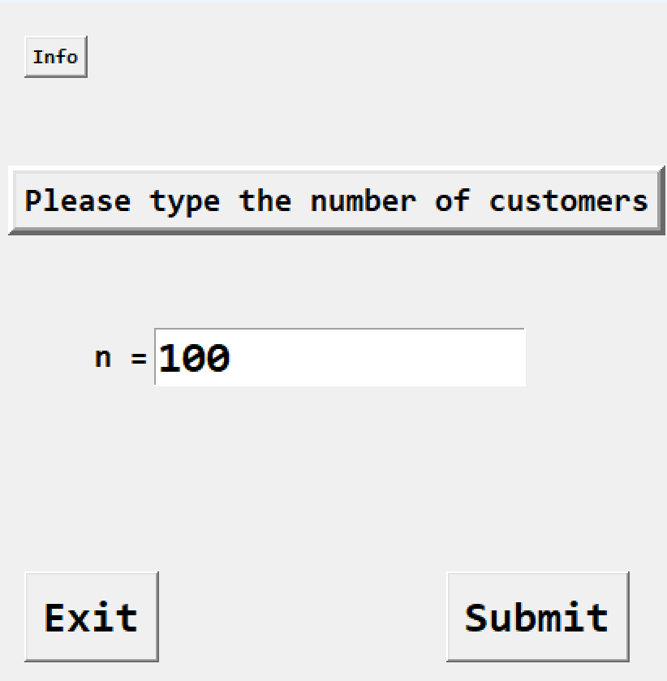
Structure of application

Slide 6
Encountered difficulties
Use of GUI elements in python
Methods implementation

Slide 7
Future work
Sublinear implementation utilizing advanced data structures
Cleaner code
Cleaner UI

Slide 8
Thank you for your attention!

